Slide 1
Function basics

Slide 2
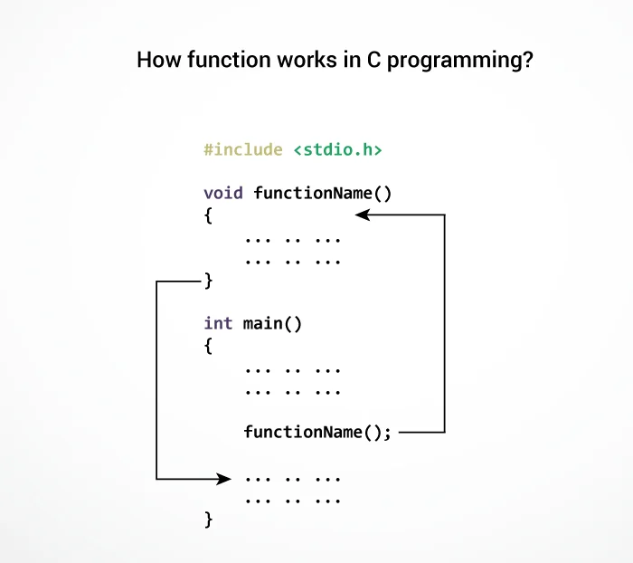
functions

Slide 3
Function basics in C
A function is a collection of C statements to do something specific. A C program consists of one or more functions. Every program must have a function called main().
Advantages of functions
A large problem can be divided into subproblems and then solved by using functions.
The functions are reusable. Once you have created a function you can call it anywhere in the program without copying and pasting entire logic.
The program becomes more maintainable because if you want to modify the program sometimes later, you need to update your code only at one place.

Slide 4
Types of function
Types of function
Library function
User defined function

Slide 5
Library function
C has many built-in library functions to perform various operations, for example:
sqrt() function is used to find the square root of a number.
Similarly, scanf() and printf() are also library functions, we have been using them since chapter 1 - Intro to C programming.
To use a library function we must first include corresponding header file using #include preprocessor directive. For scanf() and printf() corresponding header file is stdio.h, for sqrt() and other mathematical related functions, it is math.h.

Slide 6
Continue…
// Program to find the square root of a number
#include<stdio.h>
#include<math.h>
int main()
{
float a;
printf("Enter number: ");
scanf("%f", &a);
printf("Square root of %.2f is %.2f", a, sqrt(a));
// signal to operating system program ran fine
return 0;
}

Slide 7
User defined function
User created function is known as user-defined functions. To create your own functions you need to know about three things.
Function definition.
Function call.
Function declaration.

Slide 8
Function definition
A function definition consists of the code that makes the function. A function consists of two parts function header and function body.
Here is the general syntax of the function.
return_type function_name(type1 argument1, type2 argument2, ...)
{
local variables;
statement1;
statement2;
return (expression);
}

Slide 9
Continue…
The first line of the function is known as function header. It consists of return_type, function_ name and function arguments.
The return_type denotes the type of the value function returns for e.g int, float etc. The return_type is optional, if omitted then it is assumed to be int by default. A function can either return one value or no value at all, if a function doesn't return any value, then the void is used in place of return_type.
function_name is the name of the function. It can be any valid C identifier. After the name of the function, we have arguments declaration inside parentheses. It consists of type and name of the argument. Arguments are also known as formal arguments. A function can have any number of arguments or even no arguments at all. If the function does not have any arguments then the parentheses are left empty or sometimes void is used to represent a function which accepts no arguments.

Slide 10
Continue…
The body of the function is the meat of the function, this is where you will write your business logic. The body of the function is a compound statement (or a block), which consists of any valid C statements followed by an optional return statement. The variables declared inside function are called local variables because they are local to the function, means you can’t access the variables declared inside one function from another function. The return statement is used when a function needs to return something to its caller. The return statement is optional. If a function doesn't return any value then it's return_type must be void, similarly if a function returns an int value its return_type must be int.

Slide 11
Function call
After the function is defined the next step is to use the function, to use the function you must call it. To call a function you must write its name followed by arguments separated by a comma (,) inside the parentheses ().
int product(int num1, int num2)
{
int result;
result = num1 * num2;
return result;
}
For example, here is how we can call the product() function we created above.
product(12, 10);
Here we are passing two arguments 12 and 10 to the function product(). The values 12 and 10 will be assigned to variables num1 and num2 respectively.

Slide 12
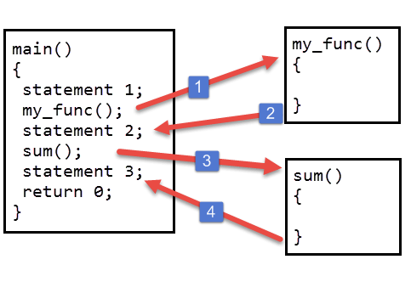
Continue…
If a function accepts no arguments then it must be called using empty parentheses.
my_func();
The following figure describes what happens when you call a function.

Slide 13
Continue…
When my_func() function is called from main() the control passes to the my_func(). At this point the activity of the main() function is temporarily suspended; it falls asleep while my_func() function goes to work. When my_func() function finishes its task or when there are no more statements to execute, the control returns back to main() function. The main() wakes up and statement2 is executed. Then in the next line sum() function is called and control passes to the sum(). Again activity of main() function is temporarily suspended, until sum() is being executed. When sum() runs out of statement to execute, control passes back to main(). The function main() wakes up again and statement3 is executed. The important point to note is that main() function is calling my_func() and sum(), so main() is calling function whereas my_func() and sum() are called functions.

Slide 14
Function declaration / Function prototype
The calling function needs some information about the called function. When function definition comes before the calling function then function declaration is not needed. For example:
#include<stdio.h>
// function definition
int sum(int x, int y)
{
int s;
s = x + y;
return s;
}
int main()
{
// function call
printf("sum = %d", sum(10, 10));
// signal to operating system everything works fine
return 0;
}

Slide 15
Continue…
Notice that the definition of function sum() comes before the calling function i.e. main(), that’s why function declaration is not needed.
Generally function definition comes after main() function. In this case, the function declaration is needed.
Function declaration consists of function header with a semicolon (;) at the end.
Here are function declarations of function my_func() and sum().
void my_func(void);
int product(int x, int y);

Slide 16
Continue…
Names of arguments in a function declaration is optional so,
int product(int x, int y)
can be written as:
int product(int , int )
Note that return type and argument types must be same as defined while creating the function. So you can't write the following:
float product(int a, int b) – wrong because product() function return type is int.
int product(float a, int b) – wrong because product() function first argument is of int type.

Slide 17
Continue…
Another important point is that the name of the arguments defined in the function declaration needs not to be the same as defined in the function definition.
int sum(int abc, int xyx) // Function declaration
int sum(int x, int y) // Function definition
{
int s;
s = x + y;
return s;
}

Slide 18
Continue…
A function declaration is generally placed below preprocessor directives.
The following program demonstrates everything we have learned so far.
#include<stdio.h>
// function declaration
int sum(int x, int y);
int main()
{
// function call
printf("sum = %d", sum(10, 10));
// signal to operating system everything works fine
return 0;
}
// function definition
int sum(int x, int y)
{
int s;
s = x + y;
return s;
}

Slide 19
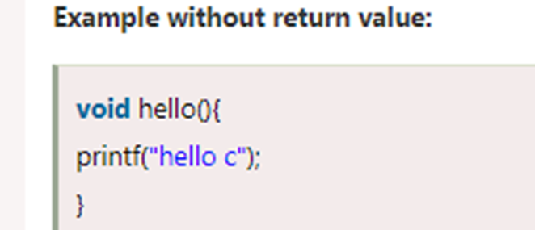
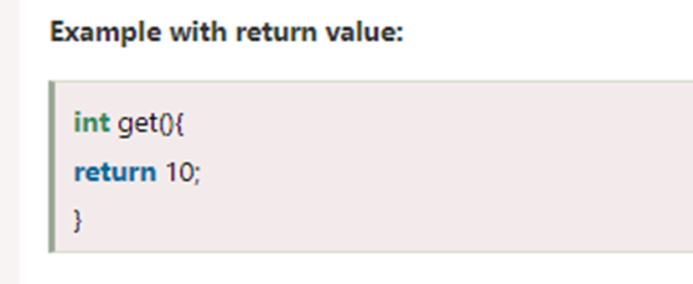
Return Value
A C function may or may not return a value from the function. If you don't have to return any value from the function, use void for the return type.

Slide 20
Different aspects of function calling
A function may or may not accept any argument. It may or may not return any value. Based on these facts, There are four different aspects of function calls.
function without arguments and without return value
function without arguments and with return value
function with arguments and without return value
function with arguments and with return value

Slide 21
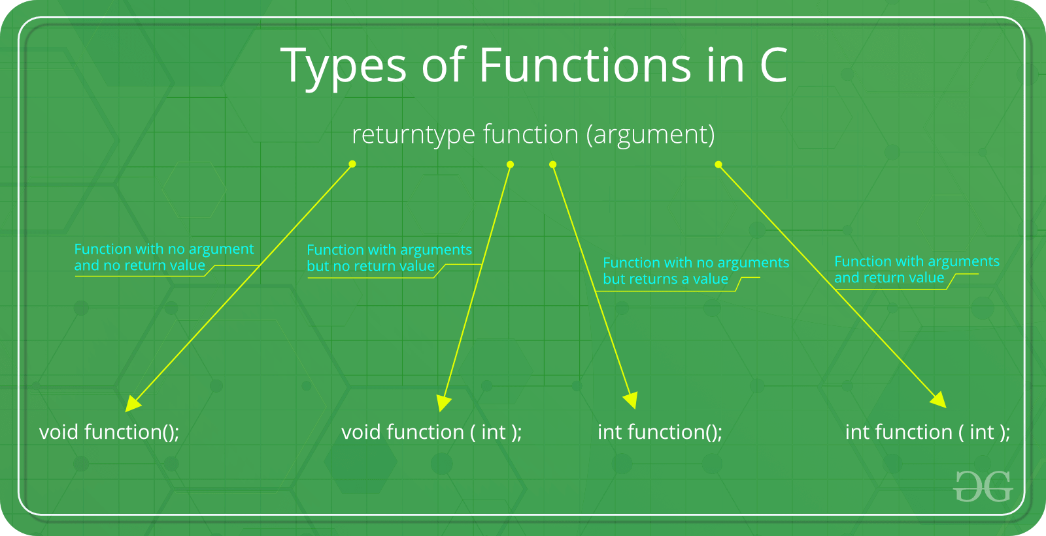
Continue…

Slide 22
Function with no argument and no return value :
When a function has no arguments, it does not receive any data from the calling function. Similarly when it does not return a value, the calling function does not receive any data from the called function.
Syntax :
Function declaration : void function();
Function call : function();
Function definition :
void function()
{
statements;
}

Slide 23
Function with arguments but no return value:
When a function has arguments, it receive any data from the calling function but it returns no values.
Syntax :
Function declaration : void function ( int );
Function call : function( x );
Function definition:
void function( int x )
{
statements;
}

Slide 24
Function with no arguments but returns a value
There could be occasions where we may need to design functions that may not take any arguments but returns a value to the calling function. A example for this is getchar function it has no parameters but it returns an integer an integer type data that represents a character.
Syntax :
Function declaration : int function();
Function call : function();
Function definition :
int function()
{
statements;
return x;
}

Slide 25
Function with arguments and return value:
Syntax :
Function declaration : int function ( int );
Function call : function( x );
Function definition:
int function( int x )
{
statements;
return x;
}

